Slide 1

TryStack.org
A Sandbox for OpenStack

Slide 2
Why TryStack?
Help developers get familiar with the OpenStack APIs
Generate a knowledge base of information for administrators, operators and deployers
Allow testing of reference architectures
Hardware setups
Configuration of OpenStack
Multiple versions of OpenStack
Provide useful bug reports and feature requests back to upstream OpenStack projects

Slide 3
Boom.
TryStack announced February 16th
Already 800+ users
Half a dozen volunteer admins
#trystack on Freenode.net

Slide 4
TryStack - Today - Hardware
A single region -- the "Dell Region"
20 servers - (5) 2U Dell C6105s server enclosures
2 12-core Xeon or Opteron processors
96GB RAM
~5TB usable disk space
Dual-NIC
2 Cisco 4948-10GE switches
One used for public IP address network
One used for private management network
1 Dell switch
Public Internet gateway

Slide 5
TryStack - Today - Architecture
One (1) management node
jenkins, dnsmasq, chef-server, nagios, munin
Three (3) HA pairs of servers
nova-api, nova-scheduler, keystone, dashboard
glance-api, glance-registry
mysql-server, rabbitmq-server
Thirteen (13) service nodes
nova-compute, nova-network

Slide 6
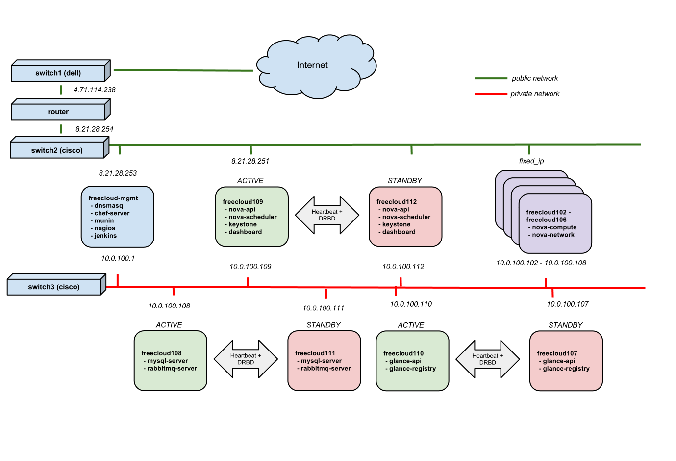

Slide 7
TryStack - Today - Software
OpenStack Diablo code base
Ubuntu 11.04 (Natty) base OS image for all servers
Unmodified Nova, Glance, Keystone "Legacy", and Dashboard
Custom billing dashboard module (Stack Dollars!)
A few custom scripts (with inspiration from devstack) for packaging needs

Slide 8
TryStack - Today - Deployment
Deployed using Chef
https://github.com/trystack/openstack-chef (stable/diablo)
Mostly stock upstream cookbooks plus a few files specific to TryStack:
Example: main trystack.org landing page in cookbooks/dashboard/files/default/html/*
Execute IPMItool commands from freecloud-mgmt to verify power status and reboot machines
Execute chef commands from freecloud-mgmt for deployments

Slide 9
TryStack - Today - Deployment
Management node contains local git repository for Chef cookbooks, billing dashboard module, and packaging scripts
Make changes to recipes and roles on management node, upload changes to chef server (running on management node)
Use Chef Web UI to make changes to attributes, environment and databags
Jenkins has a number of jobs including a chef-execute-all job that runs:
sudo -i knife ssh name:freecloud* -x stack\
'sudo chef-client -N `hostname`'

Slide 10
TryStack - Today - Monitoring
Nagios provides real-time snapshot of server health
Munin provides historical graphs of performance information
Jenkins jobs do cleanup and monitoring
#trystack-admins restricted IRC channel for admins
If you're interested, let us know! :)

Slide 11
Boom! Lots of pain from Day 1
AppArmor kills compute nodes
mdadm/RAID setup issues
Nova services often die
Sometimes difficult to debug why
Many instances left in BUILD state indefinitely
No HA initially
Snapshots didn't work
Turned out to be /tmp was on a ramdisk with too little room
Total hack job put into Chef cookbooks to ln -s /opt/stack/tmp /tmp because we couldn't for the life of us figure out how to get Chef to modify the TMPDIR env variable for the user running nova-compute
Wanted easy signup with no spam
Ended up using Facebook group -- and the whining started immediately
Nati plugged in a Facebook login module

Slide 12
TryStack - Tomorrow - OK... April..ish
New HP hardware zone - tripling our capacity!
Upgrade to Essex code base
Upgrade base OS install to Ubuntu 11.10 or 12.04
Add Swift!
More flexible signup/registration
Additional HP hardware region
Publish user guide and FAQ on trystack.org
Publish monitoring stats and graphs
Publish sanitized log files
Publish lessons learned in admin/ops
More and more automated jobs and diagnostics tools

